Slide 1
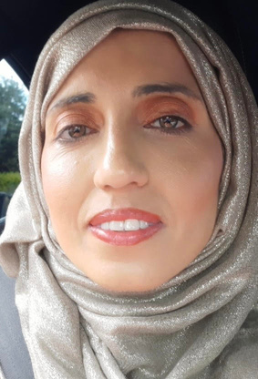







Meet The
T
E
A
C
H
E
R
Shamsa Nasreen
School Teacher
About Me
I am Shamsa Nasreen and teaching is my passion. I want our pupils to elevate and reach their horizons no matter what challenges we might face. No doubt we will be a on a journey together. I enjoy reading and I am bilingual in two languages. I love acting, role plays and creative writing with expression of empathy. Cooking a variety of authentic dishes is my absolute hobby.
Education
Contact Me
Shamsa.nasreen@safestartschooltameside.com
Fully qualified teacher status.
0161 523 5444
1 Henry Square 0L6 7SR
Biology degree from the university of Manchester.
Taking part in ongoing
“Do all the good you can by all the means you can.”
training.

